Slide 1
Switches
Combined
Taken from Slides provided by
S Ward Abingdon and Witney College and St. Clair College in Windsor, Ontario

Slide 2
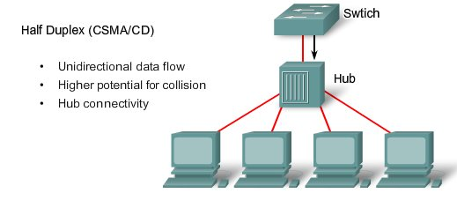
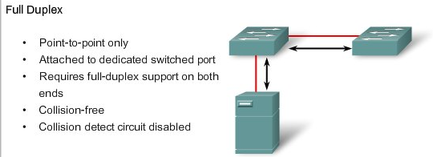
Ethernet Communications
Efficiency is typically rated at 50 to 60 percent of the 10-Mb/s bandwidth.
100 percent efficiency in both directions.

Slide 3
Switch Port Settings
AUTO:
Auto-negotiation of duplex mode. The two ports communicate to determine the best mode.
Default for FastEthernet and 10/100/1000 ports.
Auto is fine if both devices are using it. Potential problem if switch uses it and other device does not. Switch defaults to half.
FULL:
Full-duplex mode.
Default for 100BASE-FX ports.
HALF:
Half-duplex mode.
Full one end and half the other – errors.

Slide 4
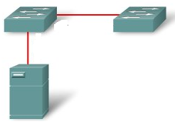
Switch Port Settings
Straight Through Cable
Cross Over Cable
Auto-MDIX feature:
Command makes switch detect whether cable is straight through or crossover and compensate so you can use either.
Depends on IOS version
Enabled by default from 12.2(18)SE on
Notes:
automatic medium-dependent interface crossover (auto-MDIX) feature

Slide 5
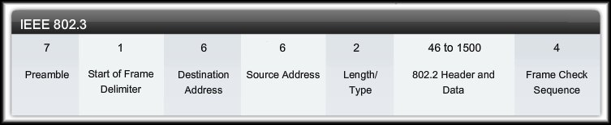
Ethernet Communications
Ethernet Frame: Minimum 64 bytes, Maximum 1518 bytes
Preamble/SOFD: To synchronize.
Destination Address: MAC Address of destination device.
Source Address: MAC address of source device.
Length/Type: Length of frame or protocol type code.
Data: Encapsulated data from OSI Layers 7 to 3.
FCS: Frame Check Sequence.

Slide 6
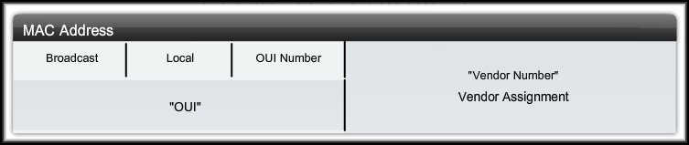
Ethernet Communications
MAC Address: 12 hexadecimal digits
Broadcast: Indicates a broadcast or multicast frame.
Local: indicates whether the address can be modified locally.
OUI Number: Manufacturer of the NIC, allocated by IEEE
Vendor Number: Unique identifier for port on device, vendor assigned number.

Slide 7
Switch MAC Address Table
Table matches switch port with MAC address of attached device
Built by inspecting source MAC address of incoming frames
Destination MAC address checked against table, frame sent through correct port
If not in table, frame flooded
Broadcasts flooded

Slide 8
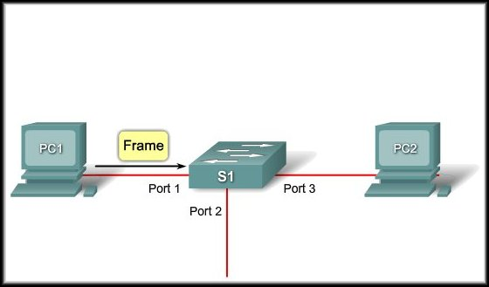
Switch MAC Address Table
Example Step 1:
The switch receives a broadcast frame from PC 1 on Port 1.

Slide 9
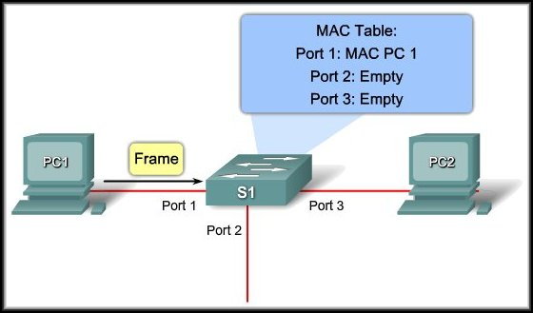
Switch MAC Address Table
Example Step 2:
The switch enters the source MAC address and the switch port that received the frame into the address table.

Slide 10
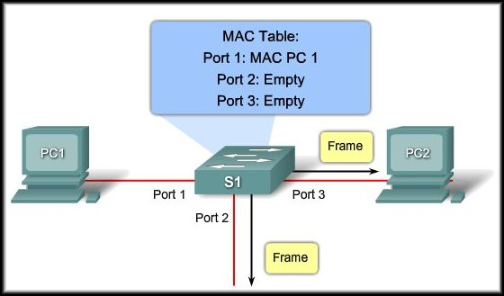
Switch MAC Address Table
Example Step 3:
Because the destination address is a broadcast, the switch floods the frame to all ports, except the port on which it received the frame.

Slide 11
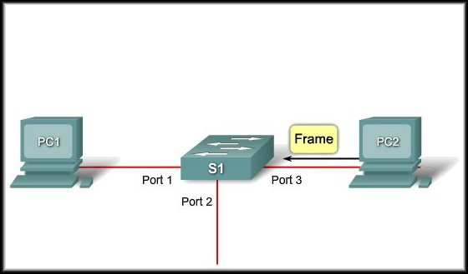
Switch MAC Address Table
Example Step 4:
The destination device replies to the broadcast with a unicast frame addressed to PC 1.

Slide 12
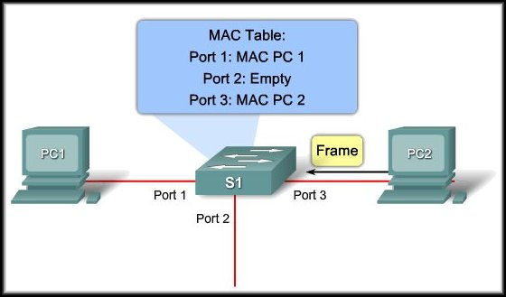
Switch MAC Address Table
Example Step 5:
The switch enters the source MAC address of PC 2 and the port number of the switch port that received the frame into the address table.
The destination address of the frame and its associated port is found in the MAC address table.

Slide 13
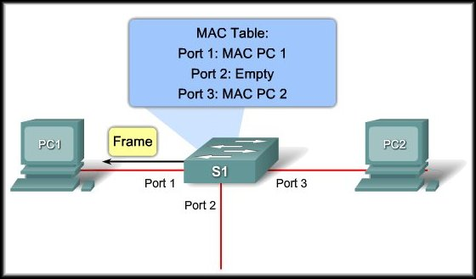
Switch MAC Address Table
Example Step 6:
The switch can now forward frames between source and destination devices because it has entries in the address table that identify the associated ports.

Slide 14
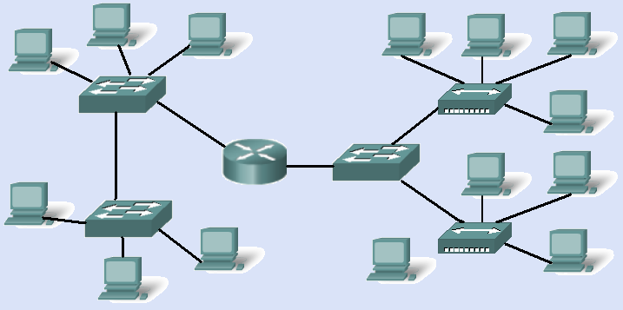
How many collision domains?

Slide 15
How many collision domains?
11

Slide 16
Broadcast Domains
Layer 2 switches flood broadcasts.
Devices linked by switches are in the same broadcast domain.
A layer 3 device (router) splits up broadcast domains, does not forward broadcasts
Destination MAC address for broadcast is all 1s, that is FF:FF:FF:FF:FF:FF
(We ignore VLANs here – they come later.)

Slide 17
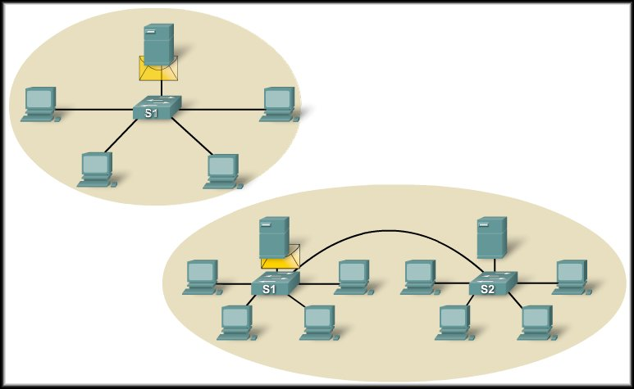
Broadcast Domains
Interconnecting switches extends the broadcast domain.

Slide 18
How many broadcast domains?
No VLANs

Slide 19
How many broadcast domains?

Slide 20
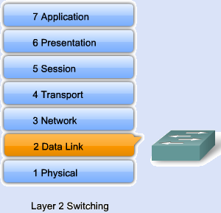
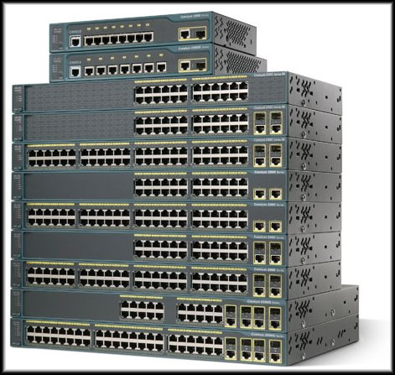
Layer 2 and Layer 3 Switching
Traditional Ethernet switches work at layer 2.
They use MAC addresses to make forwarding decisions.
They do not look at layer 3 information.
Cisco Catalyst 2960 Series

Slide 21
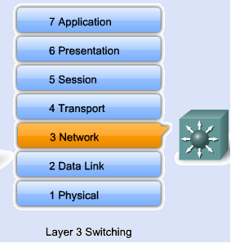
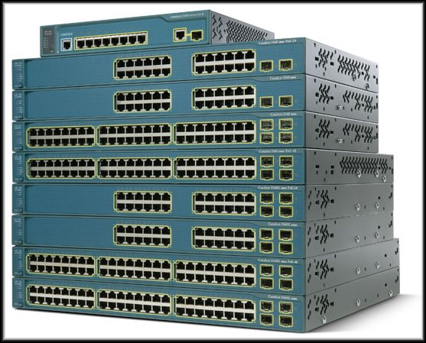
Layer 2 and Layer 3 Switching
Layer 3 switches can carry out the same functions as layer 2 switches.
They can also use layer 3 IP addresses to route between networks.
The can control the spread of broadcasts.
Cisco Catalyst 3560 Series

Slide 22
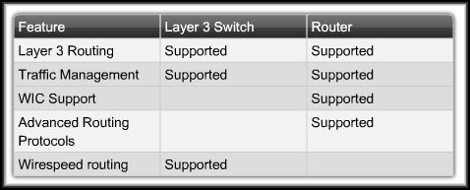
Routers and Switches
Layer 3 switches do not completely replace the need for routers on a network.
Routers perform additional Layer 3 services that Layer 3 switches are not capable of performing.

Slide 23
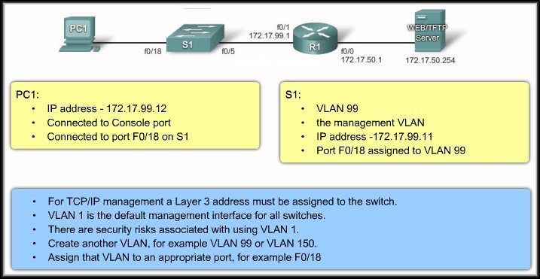
Management Interface Consideration

Slide 24
IP address for a Switch
A switch works without an IP address or any other configuration that you give it.
IP address lets you access the switch remotely by Telnet, SSH or browser.
Switch needs only one IP address.
It goes on a virtual (VLAN) interface.
VLAN 1 is the default but is not very secure for management.

Slide 25
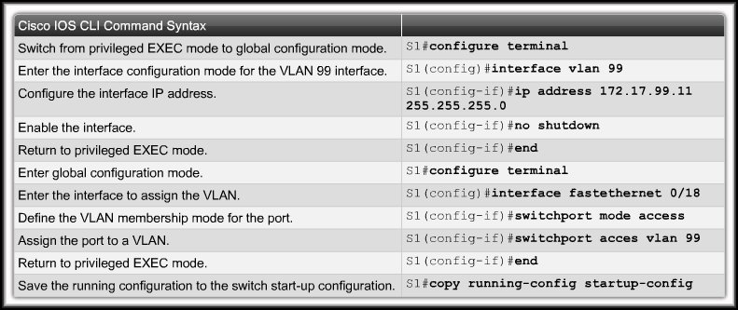
Management Interface Configuration

Slide 26
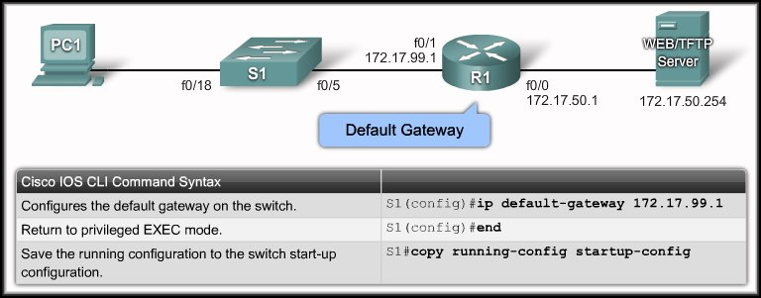
Default Gateway
You need to configure the switch so that it can forward IP packets to distant networks.
Remember, the switch is treated like a host in this setup.
This is only used to forward switch management traffic.
It has nothing to do with any of the regular user data traffic.
Why does it have to be forwarded?
You can make a Telnet or SSH connection to a switch from another subnet to perform maintenance or troubleshoot.

Slide 27
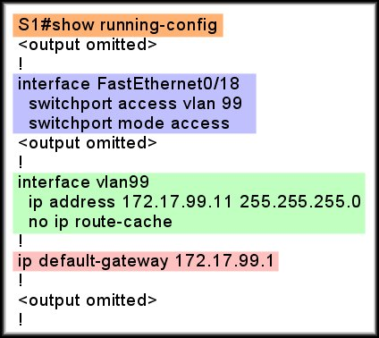
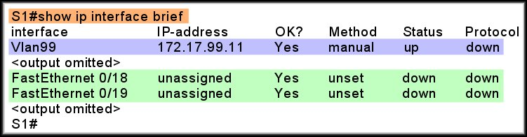
Verifying Configuration

Slide 28
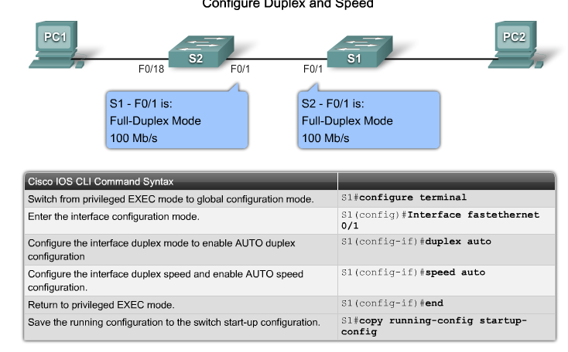
Duplex Mode and Speed

Slide 29
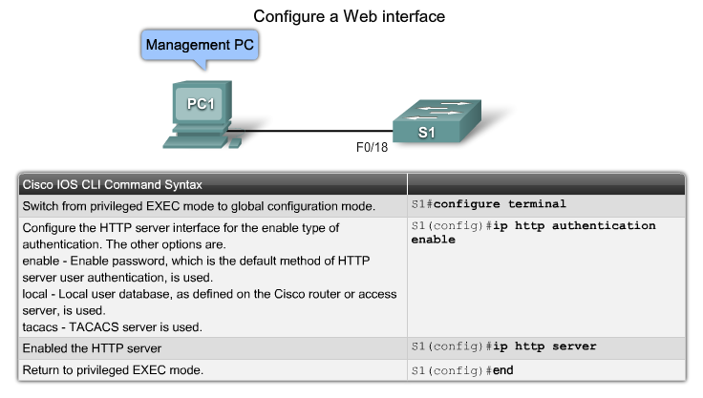
Web Interface

Slide 30
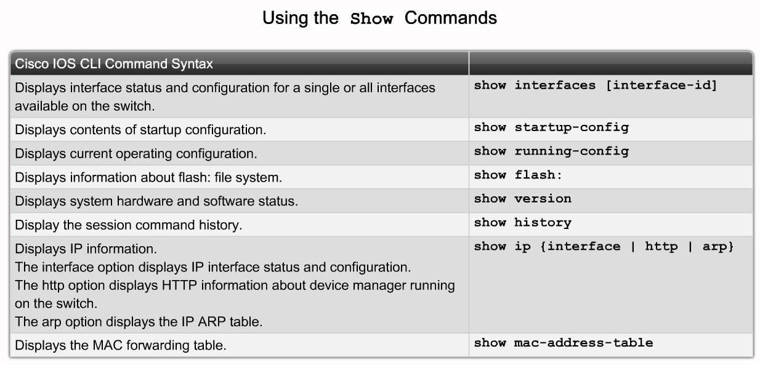
Different Show commands

Slide 31

MAC address table (CAM)
Switches use MAC address tables to determine how to forward traffic between ports.
These MAC tables include
dynamic addresses.
static addresses.

Slide 32
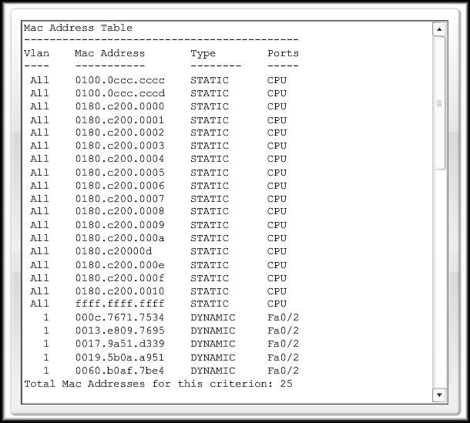
MAC address table (CAM)
Static: Inbuilt or configured, do not time out.
SW1(config)#mac-address-table static 000c.7671.10b4 vlan 2 interface fa0/6
Dynamic: Learned. Time out 300 sec.

Slide 33
Common security attacks
MAC Address FloodingDHCP spoofing
DHCP Starvation Attack
CDP Attacks
Telnet Attack
Brute Force Password Attack
DoS Attack

Slide 34
Configure Telnet and SSH
Telnet:
Most common method.
Virtual Terminal application.
Send in clear text.
Not secure.
Secure Shell (SSH):
Virtual Terminal application.
Sends an encrypted data stream.
Is secure.

Slide 35
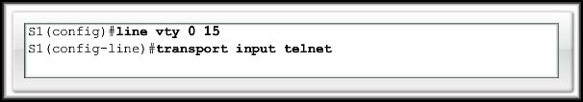
Configure Telnet and SSH
Configuring Telnet:
Telnet is the default transport for the vty lines.
No need to specify it after the initial configuration of the switch has been performed.
If you have switched the transport protocol on the vty lines to permit only SSH, you need to enable the Telnet protocol to permit Telnet access.

Slide 36
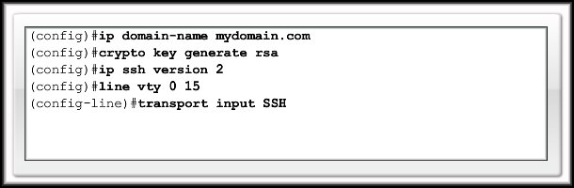
Configure Telnet and SSH
Configuring Secure Shell (SSH):
SSH is a cryptographic security feature.To use this feature, a cryptographic image must be installed on your switch.
Perform the following to configure SSH ONLY Access:

Slide 37
More security
Use strong passwords.
Even these can be found in time so change them regularly.
Using access control lists (semester 4) you can control which devices are able to access vty lines.
Network security tools for audits and penetration testing.

Slide 38
Port security
Configure each port to accept
One MAC address only
A small group of MAC addresses
Frames from other MAC addresses are not forwarded.
By default, the port will shut down if the wrong device connects. It has to be brought up again manually.

Slide 39
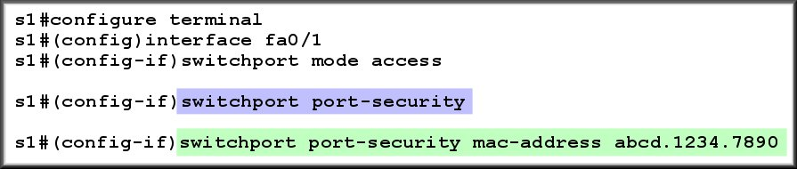
Static secure MAC address
Manually configured in interface config mode
Stored in MAC address table and in running configuration
Can be saved with the rest of the configuration.
Configure the Interface
Enable Port Security
Specify the MAC address

Slide 40
Dynamic secure MAC address
Learned dynamically
Default – learn one address.
Put in MAC address table
Not in running configuration
Not saved, not there when switch restarts.

Slide 41
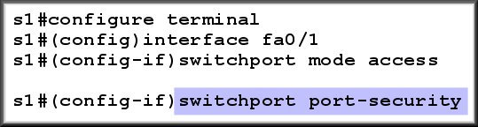
Configuring Port Security
Configure the Interface
Enable Port Security

Slide 42
Sticky secure MAC address
Dynamically learned
Choose how many can be learned, default 1.
Put in running configuration
Saved if you save running configuration and still there when switch restarts.
Existing dynamic address(es) will convert to sticky if you enable sticky learning.

Slide 43
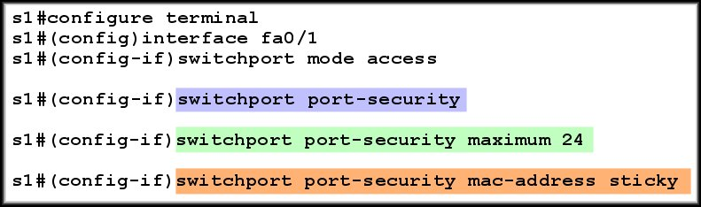
Configuring Port Security-Sticky
Configure the Interface
Enable Port Security
Specify a maximum
Enable “sticky” learning

Slide 44
Port Security: Violation Modes
Security Violation Modes:
Violations occur when:
A station whose MAC address is not in the address table attempts to access the interface and the address table is full.
An address is being used on two secure interfaces in the same VLAN.
Modes:
Protect: drop frames – no notify
Restrict: drop frames - notify
Shutdown: disable port - notify

Slide 45
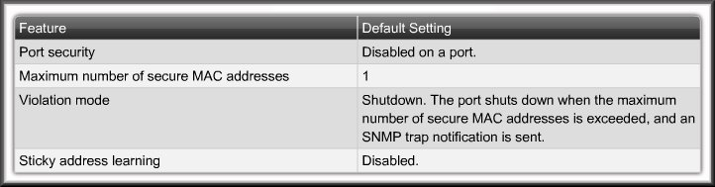
Configuring Port Security
Default Security Configuration:

Slide 46
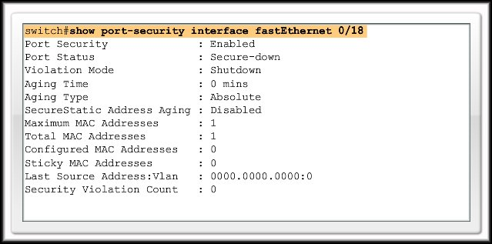
Verify Port Security
Verify Port Security Settings:

Slide 47
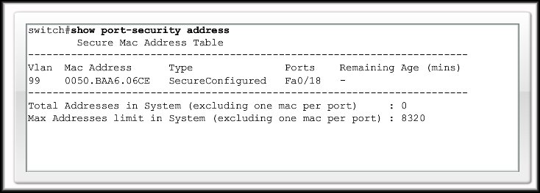
Verify Port Security
Verify Secure MAC Addresses:

Slide 48
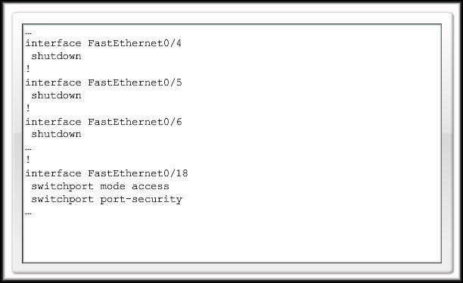
Securing Unused Ports
Disable unused ports:
You can specify a range of interfaces.
For example, to specify the first 10 interfaces:
interface range fastethernet 0/1 - 10

